Slide 1
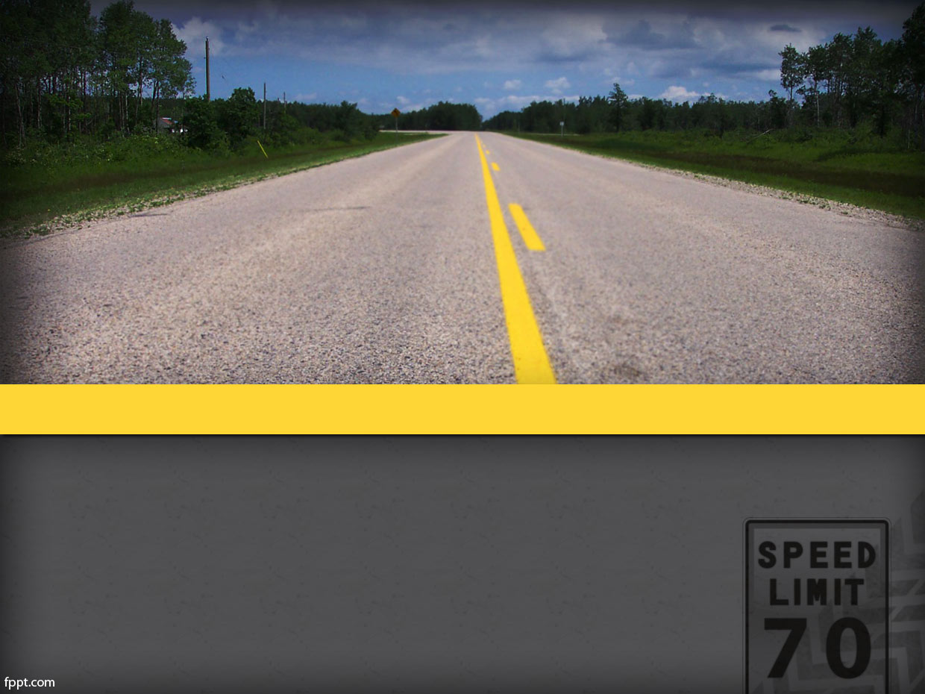
Pavement Defects Detection Based on Yolov5 and Generative Adversarial Network
DSPS Conference 2022 TJ Zhang
Steven Kim
Amanda Mullins

Slide 2
Overview
Introduction and Background
Objectives
Methods
Results and Discussion
Summary

Slide 3
Introduction
Pavement distresses
Cracking (alligator, transverse, block, longitudinal)
Manholes, patching, sealing
Prevention and identification
Intelligent pavement defect inspection
Early identification
Recovery and prevention
Current methods
Threshold segmentation, edge detection, minimal path selection
Lack in robustness
Deep learning improvements

Slide 4
Objectives
Need to improve current models
Fully Convolutional Network (FCN)
You Only Look Once (YOLO)
Dependant on provided images
Overfitting
New model improvements
Generative Adversarial Networks (GAN)

Slide 5
Methods
Preprocessing:
Pulse interface interference problem
Gaussian filter = denoise
Minus mean algorithm

Slide 6
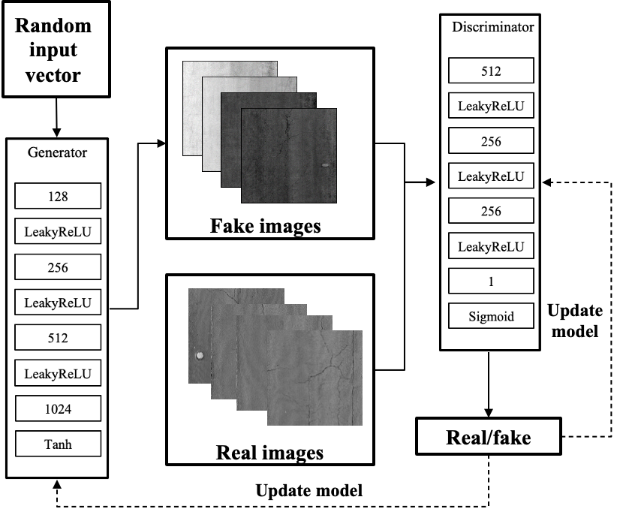
Methods (cont.)
Generative Adversarial Networks (GAN):
Goal: Generate realistic pavement surface images
Increase the number of training images
Create realistic ‘fake’ images for the model to use

Slide 7
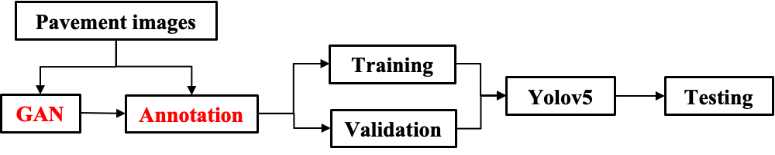
Methods (cont.)
Pavement distress task pipeline procedure:

Slide 8
Results and Discussion

